Slide 1
Multivalued Dependencies (MVDs)
Let R be a relation schema and let α ⊆ R and β ⊆ R. The multivalued dependency
α →→ β
holds on R if in any legal relation r(R), for all pairs for tuples t₁ and t₂ in r such that t₁[α] = t₂ [α], there exist tuples t₃ and t₄ in r such that:
t₁[α] = t₂ [α] = t₃ [α] = t₄ [α]
t₃[β] = t₁ [β]
t₃[R – β] = t₂[R – β]
t₄ [β] = t₂[β]
t₄[R – β] = t₁[R – β]

Slide 2
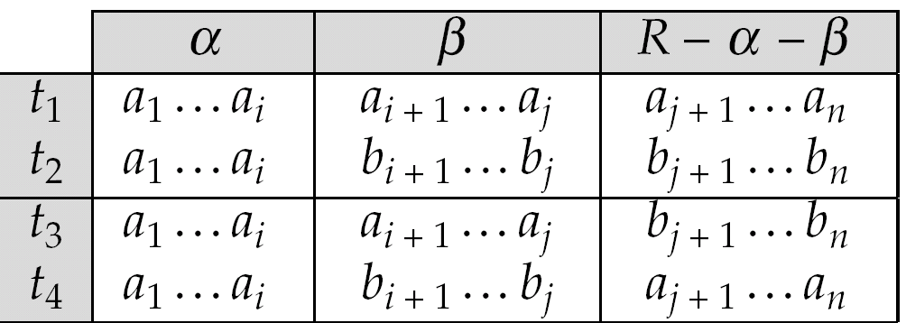
MVD (Cont.)
Tabular representation of α →→ β

Slide 3
course
teacher
book
DB
DB
DB
DB
DB
DB
OS
OS
OS
OS
Avi
Avi
Hank
Hank
Sudarshan
Sudarshan
Avi
Pete
Avi
Pete
DB Concepts
Ullman
DB Concepts
Ullman
DB Concepts
Ullman
OS Concepts
Stallings
Stallings
OS Concepts

Slide 4
Example
Let R be a relation schema with a set of attributes that are partitioned into 3 nonempty subsets.
Y, Z, W
We say that Y →→ Z (Y multidetermines Z )
if and only if for all possible relations r (R )
< y₁, z₁, w₁ > ∈ r and < y₁, z₂, w₂ > ∈ r
then
< y₁, z₁, w₂ > ∈ r and < y₁, z₂, w₁ > ∈ r
Note that since the behavior of Z and W are identical it follows that
Y →→ Z if Y →→ W

Slide 5
Example (Cont.)
In our example:
course →→ teacher
course →→ book
The above formal definition is supposed to formalize the notion that given a particular value of Y (course) it has associated with it a set of values of Z (teacher) and a set of values of W (book), and these two sets are in some sense independent of each other.
Note:
  If Y → Z then Y →→ Z
  Indeed we have (in above notation) Z₁ = Z₂
  The claim follows.

Slide 6
Use of Multivalued Dependencies
We use multivalued dependencies in two ways:
  1. To test relations to determine whether they are legal under a given set of functional and multivalued dependencies
  2. To specify constraints on the set of legal relations. We shall thus concern ourselves only with relations that satisfy a given set of functional and multivalued dependencies.
If a relation r fails to satisfy a given multivalued dependency, we can construct a relations r′ that does satisfy the multivalued dependency by adding tuples to r.

Slide 7
Theory of MVDs
From the definition of multivalued dependency, we can derive the following rule:
  If α → β, then α →→ β
That is, every functional dependency is also a multivalued dependency
The closure D⁺ of D is the set of all functional and multivalued dependencies logically implied by D.
  We can compute D⁺ from D, using the formal definitions of functional dependencies and multivalued dependencies.
  We can manage with such reasoning for very simple multivalued dependencies, which seem to be most common in practice
  For complex dependencies, it is better to reason about sets of dependencies using a system of inference rules (see Appendix C).

Slide 8
Fourth Normal Form
A relation schema R is in 4NF with respect to a set D of functional and multivalued dependencies if for all multivalued dependencies in D⁺ of the form α →→ β, where α ⊆ R and β ⊆ R, at least one of the following hold:
  α →→ β is trivial (i.e., β ⊆ α or α ∪ β = R)
  α is a superkey for schema R
If a relation is in 4NF it is in BCNF

Slide 9
Restriction of Multivalued Dependencies
The restriction of D to R_{i} is the set D_{i} consisting of
  All functional dependencies in D⁺ that include only attributes of R_{i}
  All multivalued dependencies of the form
    α →→ (β ∩ R_{i})
  where α ⊆ R_{i} and α →→ β is in D⁺

Slide 10
4NF Decomposition Algorithm
result: = {R};
done := false;
compute D⁺;
Let D_{i} denote the restriction of D⁺ to R_{i}
while (not done)
if (there is a schema R_{i} in result that is not in 4NF) then
begin
let α →→ β be a nontrivial multivalued dependency that holds
on R_{i} such that α → R_{i} is not in D_{i}, and α∩β=φ;
result := (result - R_{i}) ∪ (R_{i} - β) ∪ (α, β);
end
else done:= true;
Note: each R_{i} is in 4NF, and decomposition is lossless-join

Slide 11
Example
R =(A, B, C, G, H, I)
F ={ A →→ B
B →→ HI
CG →→ H }
R is not in 4NF since A →→ B and A is not a superkey for R
Decomposition
a) R₁ = (A, B) (R₁ is in 4NF)
b) R₂ = (A, C, G, H, I) (R₂ is not in 4NF)
c) R₃ = (C, G, H) (R₃ is in 4NF)
d) R₄ = (A, C, G, I) (R₄ is not in 4NF)
Since A →→ B and B →→ HI, A →→ HI, A →→ I
e) R₅ = (A, I) (R₅ is in 4NF)
f)R₆ = (A, C, G) (R₆ is in 4NF)

Slide 12
Further Normal Forms
Join dependencies generalize multivalued dependencies
  lead to project-join normal form (PJNF) (also called fifth normal form)
A class of even more general constraints, leads to a normal form called domain-key normal form.
Problem with these generalized constraints: are hard to reason with, and no set of sound and complete set of inference rules exists.
Hence rarely used

Slide 13
Overall Database Design Process
We have assumed schema R is given
  R could have been generated when converting E-R diagram to a set of tables.
  R could have been a single relation containing all attributes that are of interest (called universal relation). Normalization breaks R into smaller relations.
  R could have been the result of some ad hoc design of relations, which we then test/convert to normal form.

Slide 14
ER Model and Normalization
When an E-R diagram is carefully designed, identifying all entities correctly, the tables generated from the E-R diagram should not need further normalization.
However, in a real (imperfect) design, there can be functional dependencies from non-key attributes of an entity to other attributes of the entity
  Example: an employee entity with attributes department_number and department_address, and a functional dependency department_number → department_address
  Good design would have made department an entity
Functional dependencies from non-key attributes of a relationship set possible, but rare --- most relationships are binary

Slide 15
Denormalization for Performance
May want to use non-normalized schema for performance
For example, displaying customer_name along with account_number and balance requires join of account with depositor
Alternative 1: Use denormalized relation containing attributes of account as well as depositor with all above attributes
  faster lookup
  extra space and extra execution time for updates
  extra coding work for programmer and possibility of error in extra code
Alternative 2: use a materialized view defined as
account depositor
  Benefits and drawbacks same as above, except no extra coding work for programmer and avoids possible errors

Slide 16
Other Design Issues
Some aspects of database design are not caught by normalization
Examples of bad database design, to be avoided:
Instead of earnings (company_id, year, amount ), use
  earnings_2004, earnings_2005, earnings_2006, etc., all on the schema (company_id, earnings).
    Above are in BCNF, but make querying across years difficult and needs new table each year
  company_year(company_id, earnings_2004, earnings_2005,
  earnings_2006)
    Also in BCNF, but also makes querying across years difficult and requires new attribute each year.
    Is an example of a crosstab, where values for one attribute become column names
    Used in spreadsheets, and in data analysis tools

Slide 17
Modeling Temporal Data
Temporal data have an association time interval during which the data are valid.
A snapshot is the value of the data at a particular point in time
Several proposals to extend ER model by adding valid time to
  attributes, e.g. address of a customer at different points in time
  entities, e.g. time duration when an account exists
  relationships, e.g. time during which a customer owned an account
But no accepted standard
Adding a temporal component results in functional dependencies like
customer_id → customer_street, customer_city
not to hold, because the address varies over time
A temporal functional dependency X → Y holds on schema R if the functional dependency X → Y holds on all snapshots for all legal instances r (R )
⧫
τ

Slide 18
Modeling Temporal Data (Cont.)
In practice, database designers may add start and end time attributes to relations
  E.g. course(course_id, course_title) →
    course(course_id, course_title, start, end)
    Constraint: no two tuples can have overlapping valid times
      Hard to enforce efficiently
Foreign key references may be to current version of data, or to data at a point in time
  E.g. student transcript should refer to course information at the time the course was taken

Slide 19
End of Chapter

